Slide 1


eat sure
Subhadip Samanta
IIFT Delhi

Slide 2


About
EatSure is a foodtech company which has recently rebranded itself from the formerly popular Faasos App. The rebranding is essentially done keeping in mind the development of new age user consciousness about health, hygiene and packaging process in Covid times. EatSure ecosystem is made up of the popular cloud kitchens like LunchBox, Faasos, Behrouz Biryani, The Good Bowl and others which are also available for ordering on platforms like Zomato and Swiggy
Features
EatSure is for the mindful consumer who wants to be absolutely sure of
what he/she is putting in her body-
Ingredients and Calorimeter – EatSure App declares all the ingredient used in preparing a particular dish and the nutritional facts(Calorie counts) associated with it
Users collect SurePoints with each order which can be then used to discount future orders
Objective
Create product solutions to drive repeat purchase behaviour on EatSure

Slide 3



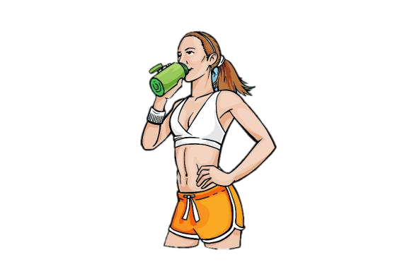
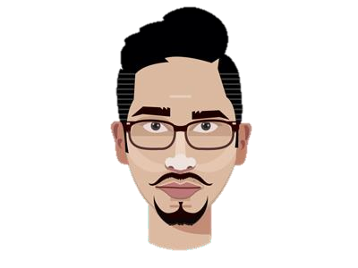





MY NAME IS RAHUL KUMAR
MY NAME IS STUTI AGARWAL
^{M}SA^{Y}TY^{N}A^{AM}NA^{E} N^{IS}DAN
34 YO, Office-Goer, Unmarried
27 YO, Employed, Fitness Enthusiast
22 YO, College student, lives in a hostel
Rahul works in a 10-7 job. He stays in a flat and has a house- help prepare his meals.
However, he often orders his office lunch/snacks from food delivery apps. He is budget conscious because he orders often and looks for pocket- friendly meal options.
Stuti is a fitness freak. Juggling between her work and responsibilities, she squeezes in time to exercise 5 days a week and tries her best to eat healthy meals on time. She has a weekend cheat day where she splurges to pacify her sweet tooth.
Satya is an Engineering student. He often finds himself bored of his mess food and doesn’t refrain from ordering his meals.
He is a binge eater- loves to watch shows while eating. Many times while studying at night, he finds himself craving for snackable foods.
User Personas

Slide 4
A is a very integral point at the beginning of the user journey. EatSure has to try to become a prominent in initial consideration step in order to ensure it retention of customer
A
EatSure?
Browses, makes up mind around what to eat
Apply any coupon and check final price
Feel Hungry, let me check some food out!
Swiggy
Zomato
Swiggy
Need to compare final price
B
Compares the final price on both - Lowest Price!?
?
Ordered!
C
Zomato
B is an important step for price conscious consumers and it is imperative for EatSure to remain price competitive in order to remain an option for comparison when it comes to making a price conscious choice
C determines how post purchase activity can help retain a customer. Swiggy and Zomato both have their subscription plans (Super and Pro), which helps in retention. This is also a point in user journey which can be looked at
Current user journey

Slide 5

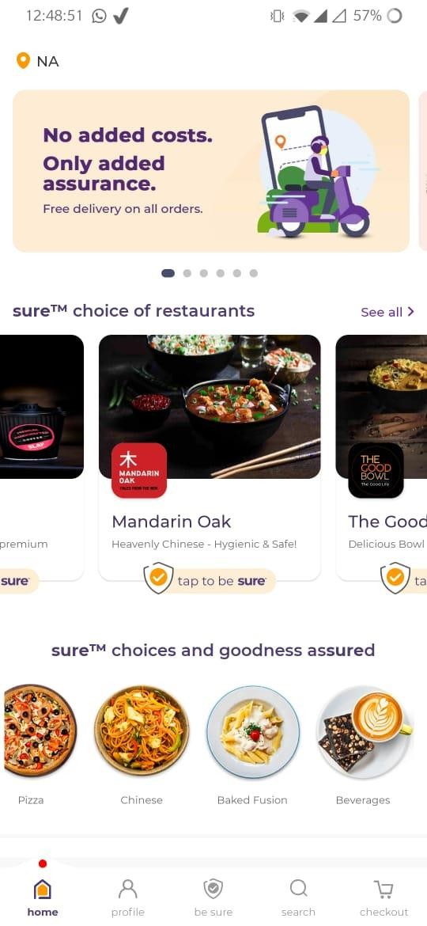
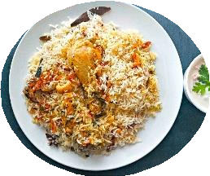
1. Gamify – Daily offers!
Feature - A daily personalised meal recommendation to a user which will be generated at 12PM and will be available for the day and offer a personalised meal at a discounted price
76
SurePo ints
dailySURE OFFER!
Rs 60 off/- on Chicken Biryani by Behrouz
Insights – The feature will increase the likelihood of a user opening the app at least once a day, prompting a repeat/ habitual behaviour.
User value proposition – The feature will be most useful for people who frequently use food delivery apps and have a great idea of all places around them delivering. This feature makes it easy for them to avoid the whole browsing and selection phase which is time taking and confusing and can have the satisfaction of eating a good meal while saving both time and money
EatSure Value Proposition –
As EatSure is an umbrella brand over all the cloud kitchen companies, we can safely assume it can exercise a greater control over discounting and supply than their competitors.
This can also have a ‘razor and blade’ effect as a customer, if not choosing the daily offer, can explore other more expensive meals and end up buying those.
Metrics to Consider –
Retention rate
Daily Active Users
No. of order placed/User
No. of times App opened in a day

Slide 6



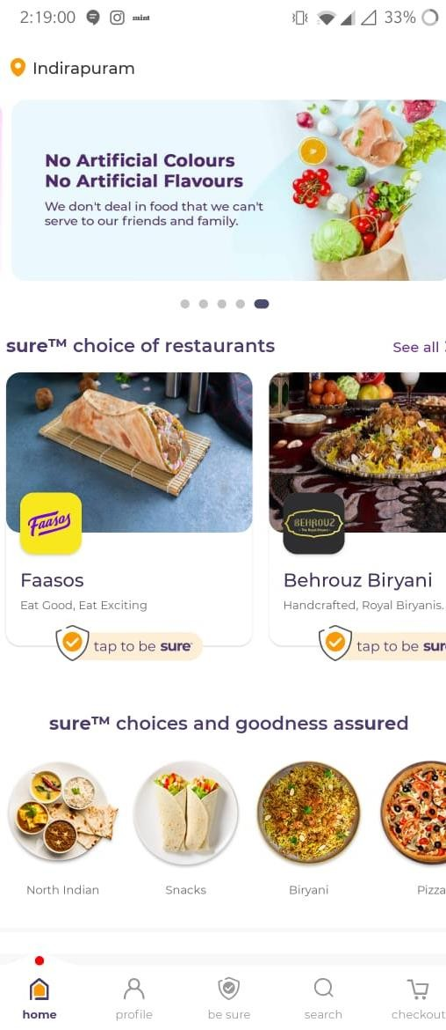

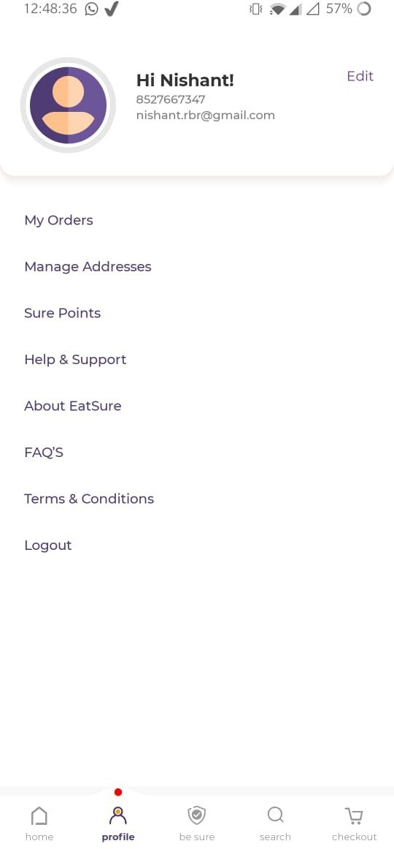



2. SurePoints Loyalty Rewards Program
760
SurePoints
Feature - Using SurePoints Reward Program to ensure long term loyalty. For the user, collecting SurePoints unlocks rewards . Ex. 5000 Surepoints will give you 10 free desserts. 10000 SurePoints will give you 15% Discount for the next 15 orders
760
SurePoints
Insight – Loyalty reward points are imperative for the long term customer retention as it helps make the customer feel valued if they belong to an exclusive club. That is why its imperative to display surePoints prominently on the home screen
Value Proposition for User – The rewards program implores the user to have a longer relationship with the app in the long term as they will derive a more value the longer they are with the app
20000
10000
Value Proposition for EatSure –
Increase Loyalty Increased Retention Higher Engagement
Metrics to consider
Average Customer LTV
MAU
LTV:CAC Ratio
5000

Slide 7

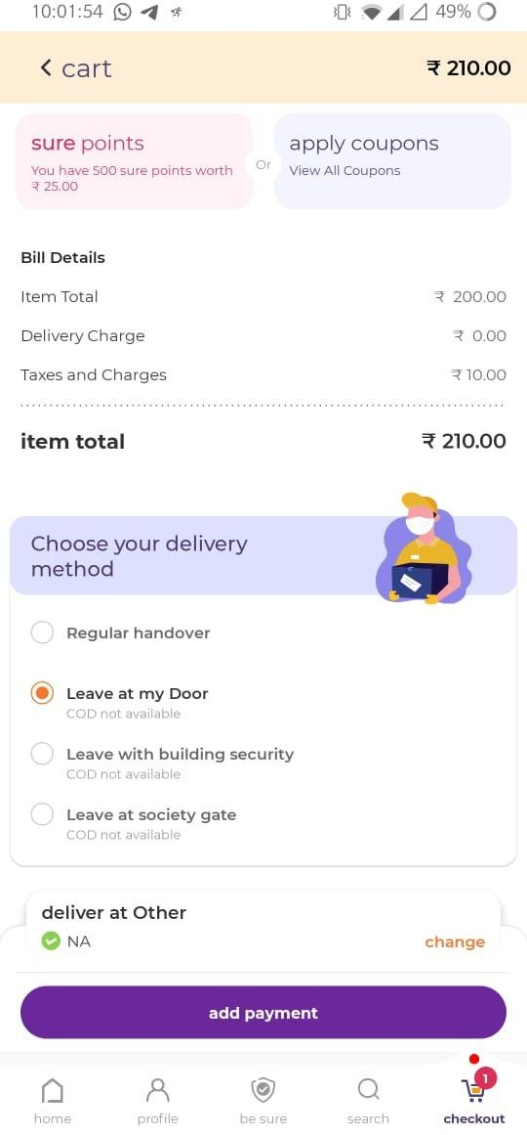
3. Retain – Add-on Discounts
Feature - An add-on value card that remains active from the 3-48hr period of the latest order. Could be a monetary discount/Could be a simple low value freebie
Insight – The primary focus is on the fact that we want to encourage repeat ordering behaviour by rewarding the consumer if he orders multiple times in short periods of times
User value proposition – The feature will be most useful for people are hostellers, and realise the value addition being done upon comparing their favourite food items and the value they can derive by ordering regularly from EatSure
Congratulations!
Order again in the next 48 hours to get an additional 5% discount.
Value Proposition to EatSure – This strategy primarily focuses on trying to retain its price conscious customer segment rewarding them basis their frequency. This will mean that the ARPO (Average revenue per order) decreases, but will in turn have great returns on the LTV from the segment.
Metrics to focus–
DAU
2D retention rate
No. of orders/User
EatSure. EatWell

Slide 8

Revenue – As most of the retention strategies involve increasing user value proposition we can expect revenue generated per order to decrease, which will hopefully by offset by the sheer increase in the number of orders.
Net Margin – Given how we are trying to aggressively provide increased bang for their buck given they increase their frequency on the app, our net margins on most orders will be reduced
CAC – Customer Acquisition costs contain all the marketing costs incurred including discount coupons etc, and hence we can see our CAC going up, which we hope to offset by drastically increasing our customer’s LTV
Metrics Wrongly Impacted!

Slide 9
Thank You

